Slide 1

Department of Computer Science and Engineering
Mini Project
Review 0
Project Synopsis Presentation
CLEAR VIEW
Under the Supervision
Prof. MOHAMMED ROQIA TABASSUM
M.TECH
Asst .Prof
Presented By:
Vishwas Tiwari 22N81A05F9
J.Shivani 22N81A05E4
P.Rekha 22N81A05D5
P.Akhil 22N81A05F2
D.Vasu 22N81A05F0
Notes:
Title of the project
CSE Dept., SET-Jain University

Slide 2
Overview
Abstract
Problem Statement
Introduction
Social/Environment Impact
State of the Art work
Design
Methodology
ER-diagram
References
*
of 12

Slide 3
Abstract
This website will allow users to conduct an online eye test, eliminating the need for in-person visits to an ophthalmologist for basic vision screenings.
The platform will utilize a series of interactive visual tests and algorithms to assess visual acuity, color blindness, and other common eye conditions.
Users will receive personalized results and recommendations based on their test performance, including guidance on seeking professional care if necessary.
The website aims to provide a convenient, accessible, and cost-effective solution for individuals to monitor their eye health and identify potential vision problem.
*
of 12

Slide 4
Problem Statement
Globally, millions lack access to eye tests and suffer from avoidable blindness and vision impairment, with a significant portion due to unaddressed refractive errors and cataracts.
Roughly 2.2 billion people have a near or distance vision impairment, and a large number of these cases are due to avoidable causes.
Online Eye Care System will be a web platform for AI-driven eye tests, providing lens power recommendations and expert
Verification. Users can take vision tests, get digital prescriptions, and track their eye health. Future features may include teleconsultation and e-commerce integration for eyewear.
*
of 12

Slide 5
Introduction
The project is in the research and planning phase, analyzing online eye test methods, AI-based vision assessment, and expert verification.
The project aims to develop an AI-powered online eye test platform for lens power detection and expert-verified prescriptions, with future scope for teleconsultation and e-commerce integration.
Assumption
Online eye tests can accurately estimate lens power within a certain margin.
AI algorithms will analyze test results to provide accurate assessments.
Medical experts will verify prescriptions to ensure accuracy.
*
of 12

Slide 6
Social/Environmental Impact
Improved Accessibility – Enables users to take eye tests remotely, reducing dependence on hospitals and clinics.
Early Detection – Helps identify vision problems early, encouraging timely medical intervention.
Cost-Effective – Provides an affordable alternative to traditional eye checkups and consultations.
Bridging Healthcare Gaps – Benefits people in remote areas with limited access to eye specialists.
Awareness & Eye Health Monitoring – Educates users about vision care and allows them to track their eye health over time.
*
of 12

Slide 7
STATE OF THE ART WORK
AI-Powered :
Autonomous Screening Companies like have developed AI-driven systems capable of autonomously analyzing retinal images to detect conditions such as diabetic retinopathy, age-related macular degeneration, and glaucoma. Their AI Eye Screening System* can assess images and generate reports in under 60 seconds, making it a valuable tool for both clinical and remote setting.

Slide 8
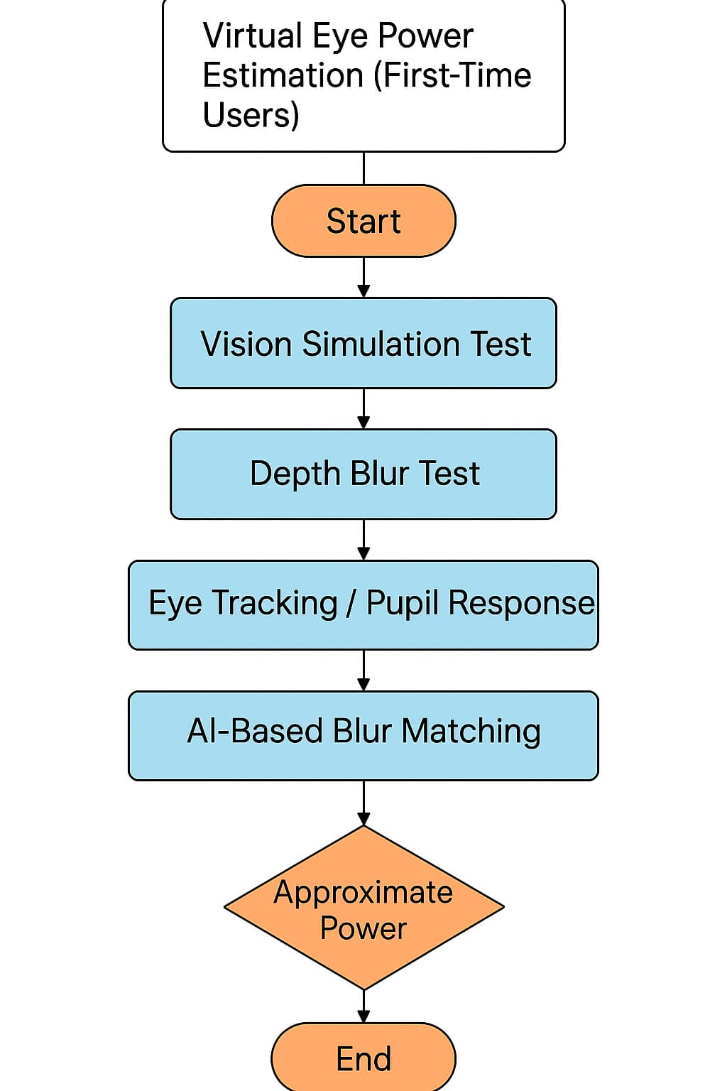
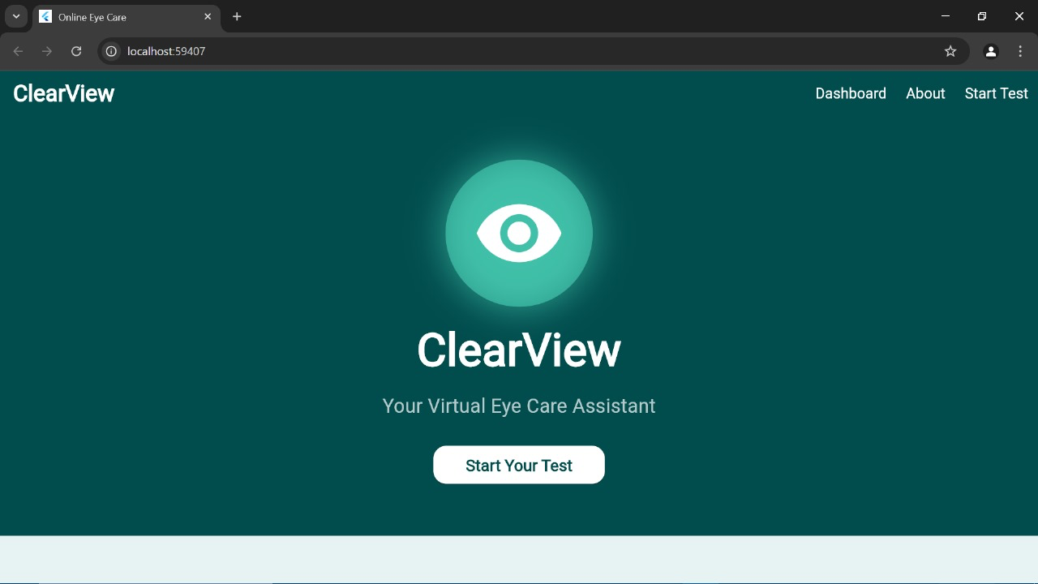
DESIGN

Slide 9
METHODOLOGIES
1. User-Centered Design
Interface adapts to user input.
Easy-to-use eye test with decreasing font sizes.
2. Agile Development
Iterative approach with continuous improvements.
Features added phase-wise: UI → Lens logic → Camera/AI.
3. MVP Strategy
Starts with core features like visual tests and power estimation.
Advanced tools like tracking and automation to be added later.
4. Scientific Lens Power Estimation
Uses:
Power (D) = 1 / Focal length (m)
Approximates power based on test results and distance.

Slide 10
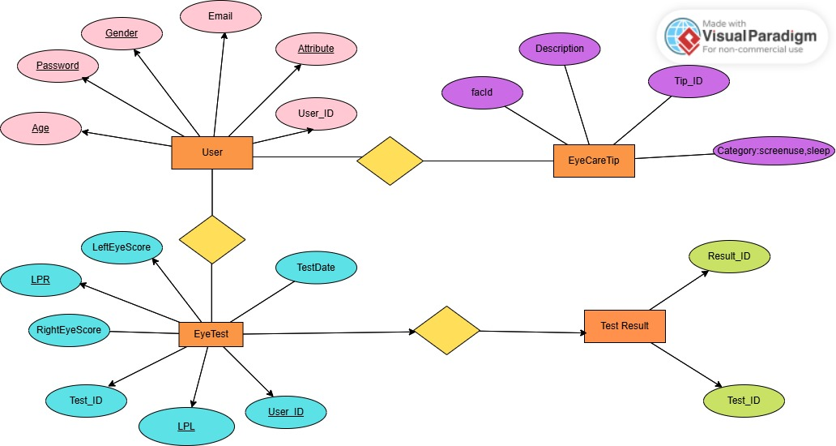

ER DIAGRAM
Gets
Takes
Generates

Slide 11
REFERENCES
Getting a Closer Look at the Eye – Wired
https://myvision.org/education/eye-anatomy
https://teachmeanatomy.info/head/organs/eye/
Getting the eye vision
https://myvision.org/education/eye-anatomy/

Slide 12
THANK YOU
*
(#) of 12

